Slide 1



Stocks and Portfolio Analytics
As of Sept 2020
Presenters:
Sharatkumar Gaonkar
Tanish Gupta

Slide 2
Agenda
1. | Objective
2. | Methodology
3. | Insight and Visualization
4. | Portfolio Analysis

Slide 3
Objective
Analyze and provide investment consultation for two clients, Mr. Patrick Jyenger and Mr. Peter Jyenger, based on their financial objectives.
Mr. Patrick Jyenger's Investment Objective:
Investment Amount: $500,000
Investment Style: Conservative
Objective: Double the capital with minimal risk over a 5-year period.
Mr. Peter Jyenger's Investment Objective:
Investment Amount: $1 million
Investment Style: High risk
Objective: Double the capital with a focus on high returns over a 5-year period.

Slide 4
Methodology
EXPLORATORY DATA ANALYSIS:
Examined the dataset for Null values and confirmed the absence of any null columns.
Conducted an analysis of outliers within the dataset.
Imputed "0" for FB data, considering its listing on NYSE on 18th May 2012.
DATA ANALYSIS:
Utilized various calculations, including daily returns, cumulative daily returns, Sharpe ratios, portfolio risk, and return on investment (ROI), to analyze stock data.
Identified the top-performing stocks for all portfolios.
Leveraged Power BI for enhanced visualizations.
Executed sector-wise analysis for a comprehensive understanding of each sector.
INFERENCES AFTER ANALYZING THE DATA:
Identified 7 stocks providing more than 80% returns over the last five years in the stock market.
Top-performing stocks include AMZN, MSFT, AAPL, FB, UNH, GOOG, and MS.
Each stock exhibits varying risk and reward based on Annualized risk, Sharpe ratio, and cumulative returns.
AMZN stands out for the highest return but carries higher risk compared to other stocks.
Stocks like JNJ, RHHBY, MRK, and MSFT demonstrate good returns with lower risk.
Sector-wise analysis reveals the best-performing sector as Technology, followed by Finance, while Aviation and Health/Pharma are among the least performing.
Concluded with finalizing portfolios tailored for both customers.

Slide 5
Insight and Visualization
Ticker | Industry | Company Name
AAL | Aviation | American Airlines Group Inc
ALGT | Aviation | Allegiant Travel Company
ALK | Aviation | Alaska Air Group Inc
DAL | Aviation | Delta Air Lines Inc
HA | Aviation | Hawaiian Holdings Inc
LUV | Aviation | Southwest Airlines Co
BCS | Finance | Barclays
CS | Finance | Credit Suisse
DB | Finance | Deutsche Bank
GS | Finance | Goldman Sachs
MS | Finance | Morgan Stanley
WFC | Finance | Wells Fargo
JNJ | Healthcare | Johnson & Johnson
MRK | Healthcare | Merck and CO inc.
PFE | Healthcare | Pfizer inc
UNH | Healthcare | UnitedHealthGroup Inc
BHC | Pharmaceuticals | Bausch Health Companies inc
RHHBY | Pharmaceuticals | Roche Holding AG
AAPL | Technology | Apple Inc
AMZN | Technology | Amazon
FB | Technology | Facebook
GOOG | Technology | Alphabet
IBM | Technology | IBM
MSFT | Technology | Microsoft
STOCKS DATA AVAILABLE
The dataset consists of 24 stocks categorized into four sectors, with six stocks in each sector.
For performance comparison, the S&P500 index, representing the top 500 stocks in the US market, serves as a benchmark.
Each stock is identified by its abbreviation, industry classification, and company name.

Slide 6
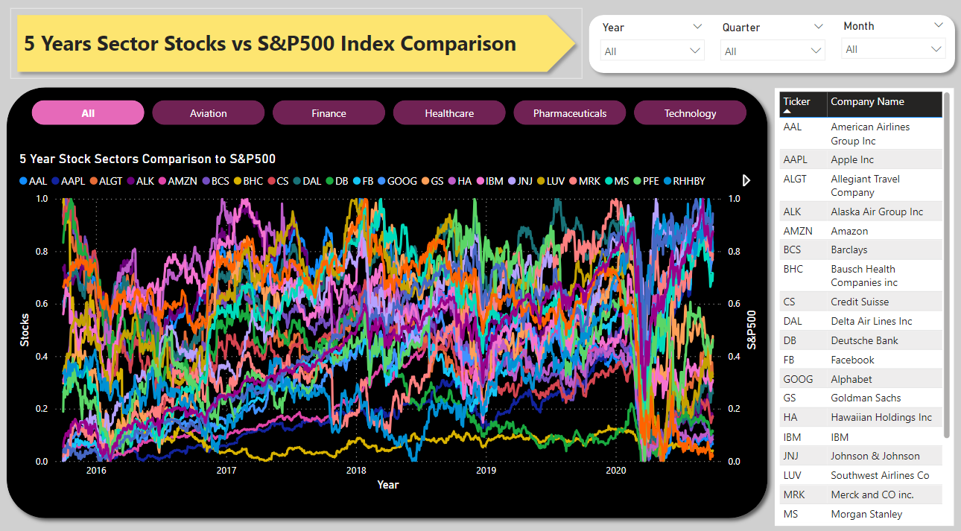
Insight and Visualization
Visualization of Normalized Stock Values:
The graph depicts the performance of each stock normalized against the S&P 500 index.
The comparison spans 10 years, providing insights into the trajectory of each stock.
During the stock analysis, it was noted that Facebook entered the market on May 18, 2012.
Enhanced functionality was introduced to the dashboard with sector-specific analysis buttons.

Slide 7
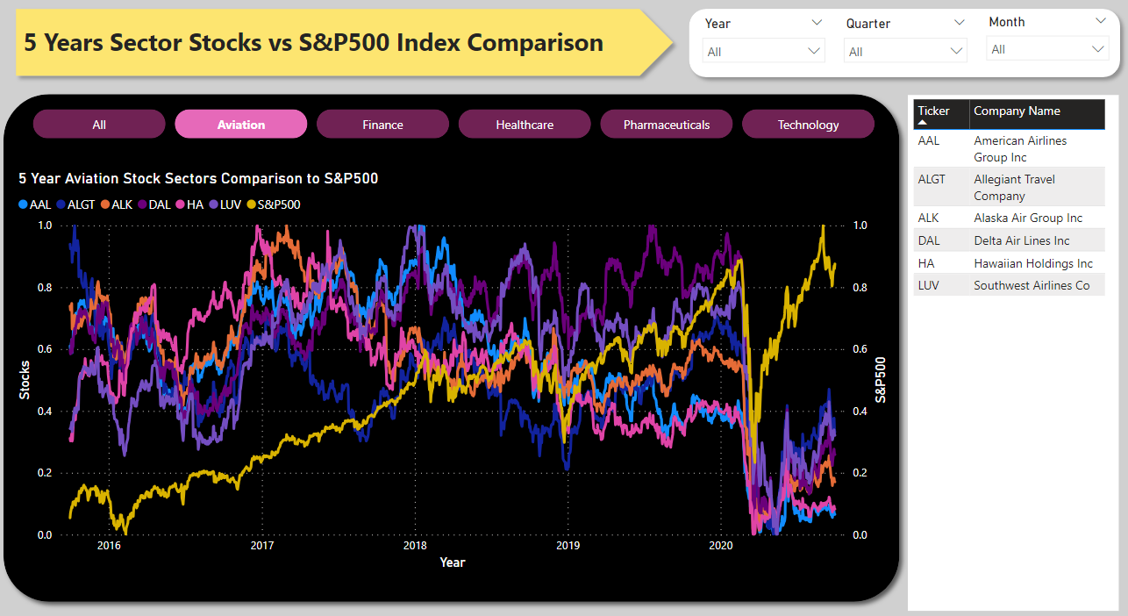
Insight and Visualization – Aviation Sector
Analysis
There is no correlation observed between the S&P500 and the Aviation Sector.
The market experienced a significant downturn in 2020 due to the COVID-19 pandemic, leading to a bear market.
Despite overall market recovery, the Aviation Sector displayed underperformance.
Allegiant Travel Company exhibits some positive correlation with Delta Airlines.
Additionally, positive correlation is noticeable between Delta Airlines and Southwest Airlines.

Slide 8
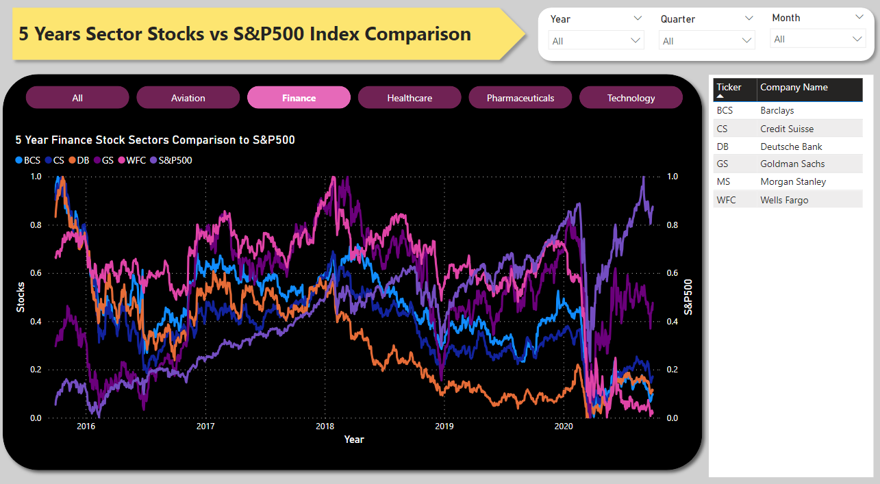
Insight and Visualization – Finance Sector
Analysis
There is a positive correlation between the S&P500 and the Finance Sector.
Despite a significant market downturn in 2020 due to the COVID-19 pandemic, both Morgan Stanley and Goldman Sachs not only recovered but also outperformed the sector.
However, the majority of stocks within the sector were adversely affected.
Notably, there is a high correlation between Goldman Sachs and Morgan Stanley when compared to other stocks.

Slide 9
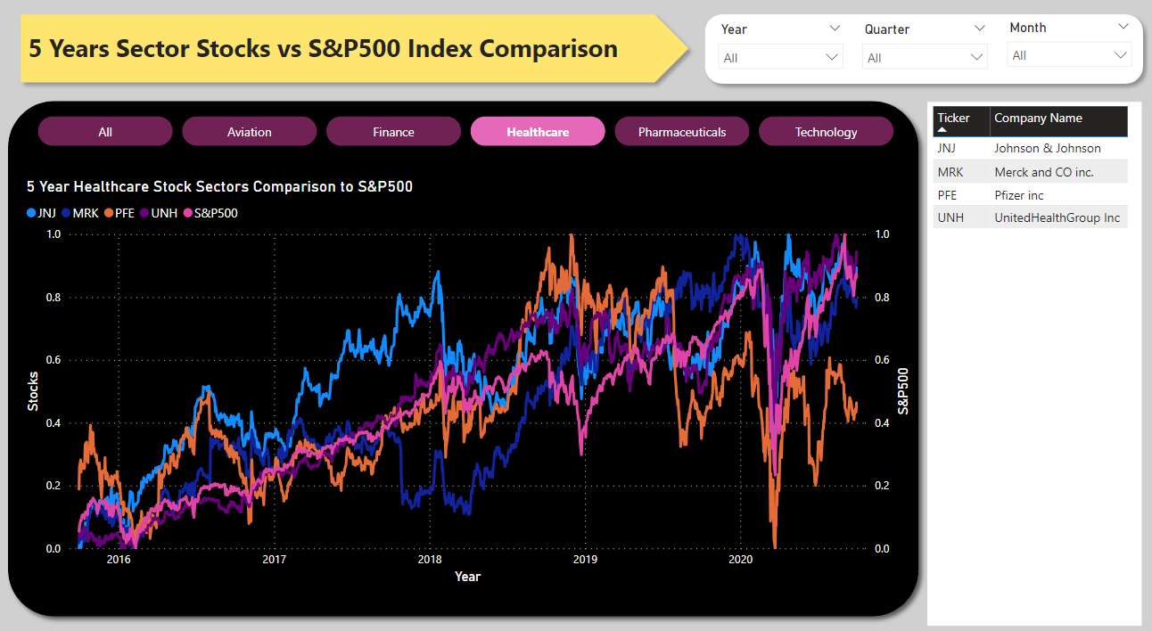
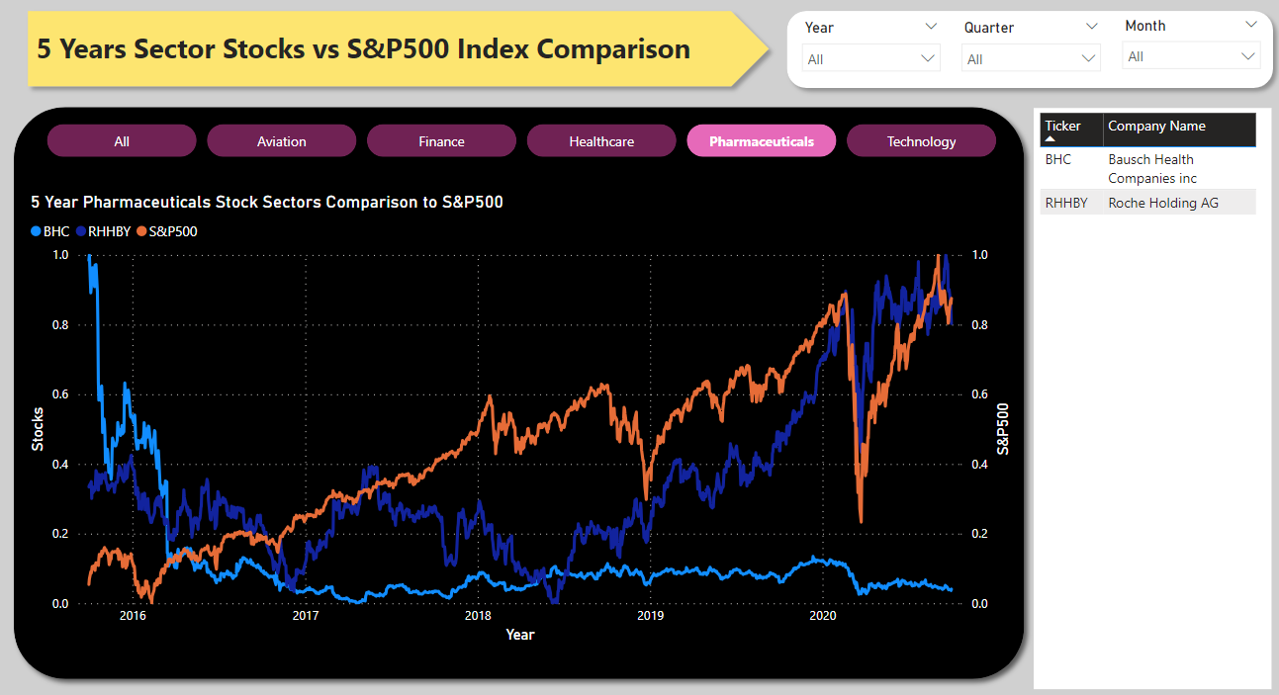
Insight and Visualization – Healthcare and Pharma Sector
Analysis
There exists a positive correlation between the S&P500 and the Health and Pharma Sector, encompassing JNJ, MRK, and UNH.
In the aftermath of the pandemic-induced market crash, both the health and pharma, as well as the technology sector, exhibited rapid growth compared to other industries.
Over the past five years, Bausch Health Companies Inc. has not demonstrated any growth.
Overall, the health and pharma sector exhibits strength when compared to the S&P500

Slide 10
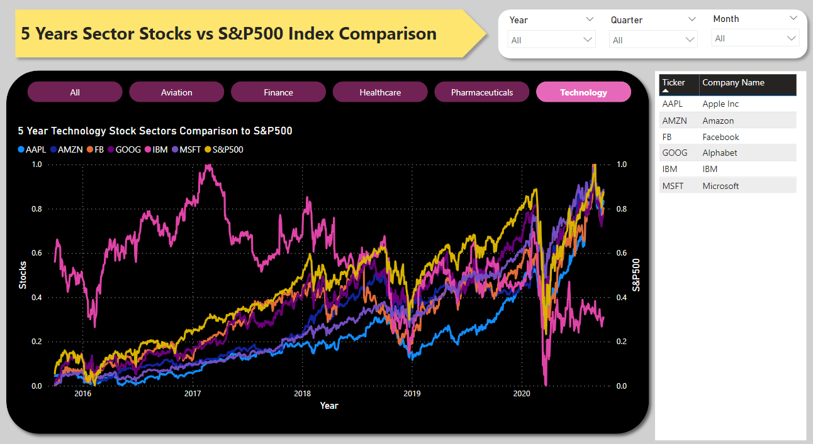
Insight and Visualization – Technology Sector
Analysis
There is a strong correlation between the S&P500 and the Technology Sector, including AMZN, FB, MSFT, GOOG, and AAPL.
Among various sectors, the Technology sector demonstrated a significant and rapid rebound during the pandemic.
With the exception of IBM, all other stocks in the sector are surpassing market performance.
Notably, there is a robust correlation among all stocks in the Technology sector, excluding IBM.

Slide 11
Insight and Visualization – Returns
Stocks | Avg Daily Returns | Risk | Min | Max | Annualized_Returns | Annualized_Risk | Sharpe_Ratio | Cumulative Returns
AMZN | 0.16 | 1.9 | -7.92 | 13.22 | 40.59 | 30.11 | 1.32 | 504.69
MSFT | 0.14 | 1.75 | -14.74 | 14.22 | 34.95 | 27.84 | 1.23 | 371.49
AAPL | 0.13 | 1.87 | -12.86 | 11.98 | 33.32 | 29.73 | 1.1 | 322.74
FB | 0.1 | 2.04 | -18.96 | 15.52 | 26.45 | 32.31 | 0.8 | 187.96
UNH | 0.09 | 1.78 | -17.28 | 12.8 | 23.72 | 28.27 | 0.81 | 167.36
GOOG | 0.08 | 1.65 | -11.1 | 10.45 | 21.02 | 26.23 | 0.77 | 140.41
MS | 0.06 | 2.18 | -15.6 | 19.77 | 14.55 | 34.62 | 0.4 | 53.49
S&P500 | 0.05 | 1.21 | -11.98 | 9.38 | 13.04 | 19.18 | 0.64 | 74.81
MRK | 0.05 | 1.41 | -8.9 | 10.41 | 12.88 | 22.33 | 0.54 | 68.02
JNJ | 0.05 | 1.25 | -10.04 | 8 | 11.35 | 19.78 | 0.54 | 59.79
GS | 0.03 | 1.99 | -12.71 | 17.58 | 7.64 | 31.59 | 0.22 | 14.17
RHHBY | 0.03 | 1.35 | -8.96 | 13.01 | 7.38 | 21.45 | 0.31 | 28.87
LUV | 0.02 | 2.29 | -15.11 | 14.44 | 6.16 | 36.37 | 0.15 | -2.37
PFE | 0.02 | 1.38 | -7.73 | 8.96 | 5.25 | 21.95 | 0.21 | 15.26
DAL | 0 | 2.65 | -25.99 | 21.02 | 1.05 | 42.03 | 0.01 | -32.66
HA | 0 | 3.31 | -26.5 | 24.58 | 0.86 | 52.6 | 0 | -47.88
IBM | 0 | 1.61 | -12.85 | 11.3 | -0.04 | 25.54 | -0.03 | -15.27
ALGT | 0 | 2.91 | -28.33 | 29.24 | -1.19 | 46.2 | -0.04 | -45.04
ALK | -0.03 | 2.69 | -23.24 | 20.31 | -6.44 | 42.71 | -0.17 | -54.34
AAL | -0.03 | 3.47 | -25.22 | 41.1 | -8.47 | 55.12 | -0.17 | -68.65
WFC | -0.04 | 2.03 | -15.87 | 14.53 | -10.44 | 32.3 | -0.35 | -54.3
CS | -0.04 | 2.28 | -18.26 | 16.34 | -11.01 | 36.26 | -0.32 | -58.61
DB | -0.05 | 2.77 | -17.49 | 14.02 | -13.33 | 44.04 | -0.32 | -68.33
BCS | -0.05 | 2.51 | -21.85 | 15.1 | -13.82 | 39.87 | -0.37 | -66.62
BHC | -0.09 | 4.46 | -51.46 | 33.74 | -22.6 | 70.72 | -0.33 | -91.35
Analysis
AMZN gives 40.59% annual returns
MSFT gives 34.95% annual returns
AAPL gives 33.32% annual returns
FB gives 26.45% annual returns
UNH gives 23.72% annual returns
GOOG gives 21.02% annual returns
MS gives 14.55% annual returns
Amazon stocks exhibit a favorable yearly return based on the average annual return. Also noted all 7 stocks give higher return than S&P500 which is 13.02%.

Slide 12
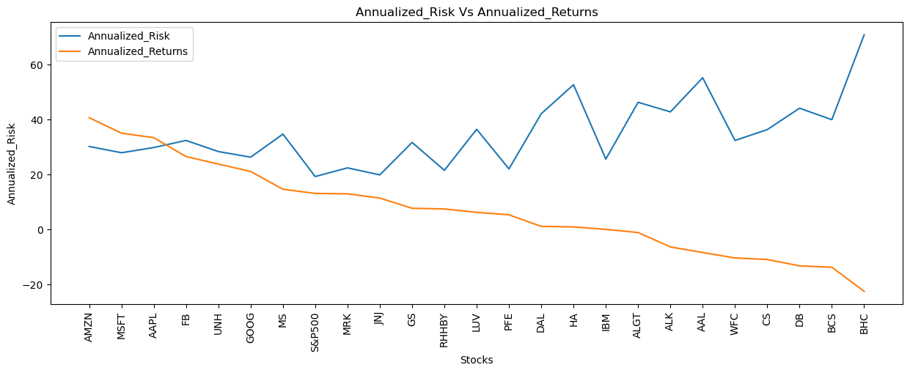
Insight and Visualization – Annualized Returns vs Risk
Analysis
The leading five stocks in terms of annualized return include AMZN, MSFT, AAPL, FB, and UNH.
Each of the top 5 stocks exhibits an annualized return exceeding 20%, and in comparison to other equities, they carry a moderate level of risk.
The probability of incurring losses and diminishing the initial investment rises with decreasing returns.
BHC, BCS, DB, CS, and WFC face larger risks, particularly since the return on investment at the time of the initial investment wasn't provided.
Companies with higher risk generally offer lower returns on investment, although some stocks present risk-free investment opportunities, albeit with less optimal returns.
Stocks such as JNJ, RHHBY, and MRK provide a favorable balance of good returns with minimal risk

Slide 13
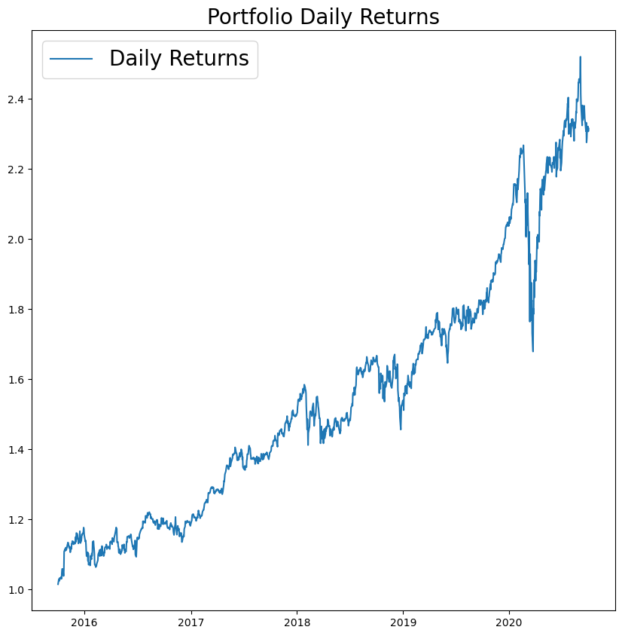
Portfolio Analysis – Mr. Patrick Jyengar
Analysis
In the upcoming five years, Mr. Patrick Jyengar aims to triple his investment, emphasizing low-risk options that can deliver respectable profits.
Considering his risk profile, low-risk equities such as JNJ, RHHBY, and GOOG are deemed suitable for purchase. However, the collective returns from these three equities alone would fall short of Mr. Patrick's investment goal. To bridge the gap and achieve the desired profits, he can allocate a portion of his wealth to MSFT.
Maintaining equal weights for all stocks, the overall weight is set at 0.25. With an investment of $500,000 in equities, Mr. Patrick anticipates returns reaching $1.15 million after a 5-year period, resulting in a gain exceeding $600,000.

Slide 14
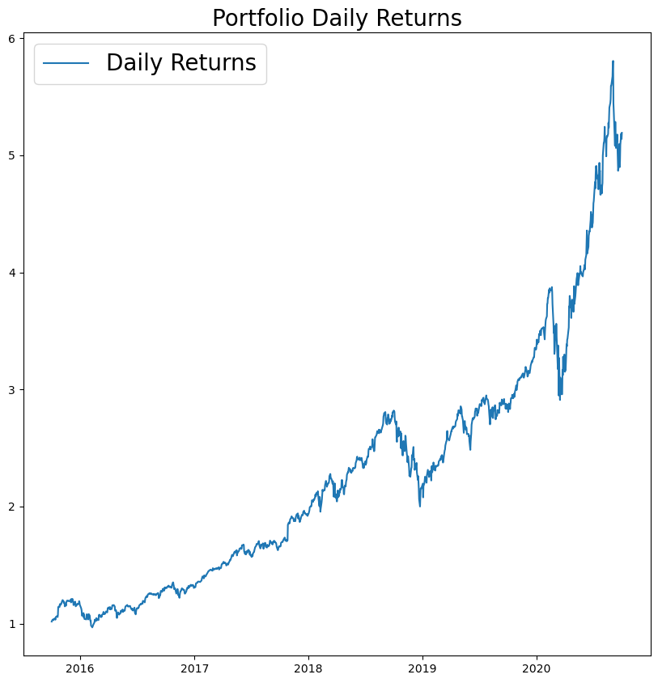
Portfolio Analysis – Mr. Peter Jyengar
Analysis
Mr. Peter Jyengar, consistent with his risk-taking approach, favors high-return investments and holds the belief that he can recover from occasional losses.
For the inorganic expansion of his company, he intends to invest $1 million from the company's cash and cash equivalents in high-margin stocks that are expected to yield substantial returns within a 5-year timeframe.
Considering his risk profile, Mr. Peter identifies high-risk/high-return stocks such as AMZN, MSFT, and AAPL as suitable investment options. The overall returns from these stocks are projected to maximize gains while accommodating the associated risk.
With a $1 million investment in equities, Mr. Peter anticipates returns exceeding $5 million after a 5-year period, resulting in a gain surpassing $4 million.

Slide 15
Thank You

